Slide 1



Dr. Hiba Shakir Ahmed
Microbiology / Clinical Immunology

Slide 2
PARAMYXOVIRUSES & RUBELLA VIRUS
Lecture 7

Slide 3
paramyxoviruses
The paramyxoviruses include the most important agents of respiratory infectious of infants and young children (parainfluenza virus).
The WHO estimates that acute respiratory infections and pneumonia are responsible every year worldwide for the death of 4 million children under 5 years of age .
all members of Paramyxoviridae family initiate infection via the respiratory tract , replication of the respiratory pathogens is limited to the respiratory epithelia.

Slide 4
The morphology of the paramyxoviridae is pleomorphic with particles 50 nm or more in diameter occasionally ranging up to 700 nm .
The envelope seems to be fragile making virus particles labile to storage conditions and prone to distortion in electron micrographs , the viral genome is linear , negative-sense single stranded RNA , non-segmented , about 15 kb in size.
Most paramyxoviruses contain six structural proteins , three proteins are complex with viral RNA and three proteins participate in the formation of the viral envelope .
The envelope contains viral hemagglutinin (HN) glycoprotein which sometimes carries neuraminidase activity and fusion (F) glycoprotein.

Slide 5
Laboratory Diagnosis
A- Antigen detection :
Direct identification of viral antigens in specimens is commonly done , antigens may be detected in exfoliated nasopharyngeal cells by direct orindirect immunofluorescences tests , these methods are rapid but less sensitivity than viral isolation and must be carefully controlled.
B- Isolation and identification of virus :
Nasal washes are good specimens for viral isolation. Bronchoalvelor lavage fluid and lung tissue have also been used. Primary monkey kidney cells are the most sensitive for isolation of parainfluenza viruses.
C- Serology :
Antibody can be measures using Neutralization test (Nt) , Haemagglutination inhibition (HI) , or ELISA test.

Slide 6
RUBELLA (GERMAN MEASLES(
Is an acute febrile illness characterized by a rash and lymphadenopathy that effects children and young adults.
It is the mildest of common viral exanthems however , infection during early pregnancy may result in serious abnormalities of the fetus including congenital malformations and mental retardation the consequences of rubella in utero are referred to as the congenital rubella syndrome.
Rubella a member of the Togaviridae family is the sole member of the genus Rubivirus , Rubella is Positive-sense, single strand RNA, non-segmented, not enveloped virus.

Slide 7
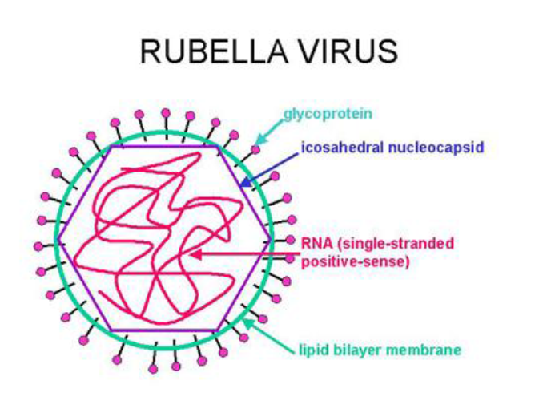

Slide 8
Laboratory Diagnosis :
Clinical diagnosis of rubella is unreliable because many viral infections produce symptoms similar to those of rubella.
A- Isolation and identification of virus :
Nasopharyngeal or throat swabs taken 6 day before and after onset of rash are a good source of rubella virus. Various cell lines of monkey or rabbit origin may be used.
B- Serology:-
The HI test is a standard serologic test for rubella however, serum must be pretreated to remove non-specific inhibitors before testing. ELISA tests are preferred because serum pretreated is not required and they can be adapted to detect specific IgM detection of IgG is evidence of immunity.

Slide 9


